Slide 1
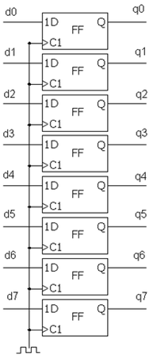
D
1Q
Shift
Register
2Q
3Q
רגיסטר 8 סיביות
Flip-Flop
יחידת חישוב
1D
Q
FF
ALU
C1
1D
Q
FF
MUX
C1
1D
Q
ENA
FF
C1
Counter
Compare

Slide 2
sel
Decoder
output
Decoder
input
Sel[0..0]
in
Out[1..0]
0
Din valid
Output_0
clk
Simple RAM
Data out
Data in
0
Output[1..0]
Addr in
input
Addr out
Dout valid
Output_1
Aout valid
RAM data
Simple RAM
Din valid
WE
clk
CLK
Data in
DATA OUT
Data out
DATA IN
1D
Q
Addr in
ENA
FF
WADDR
Addr out
C1
RADDR
Aout valid
dout valid
1D
Q
ENA
FF
C1

Slide 3
Reset
sel
Decoder
output
input
Clk
Wc to RAM
Data in
Enable out valid
WBS\WC

Slide 4
Trigger
Configuration
Trigger Type
‘0’
Trigger Position
Clk to start
Reset
System status
Trigger Type
Trigger Position
Clk to start
System status
Clk

Slide 5
Clk
System
status
Reset
System
status
wc to rc
2* Add
width_g
ALU
2* Add_width_g
rc_to_RAM
1D
Q
rc_to_RAM
FF
C1
RAM to rc
Signal_ram_width_g
Signal_ram_width_g
rc_to_WBM
rc_to_WBM
1D
Q
FF
C1

Slide 6
Trigger
‘0’
Reset
Clk
D
1Q
Shift
Register
2Q
Compare
3Q
Clk to start
Trigger
Type
Counter
System
Status
System
Status
Trigger
Position
Addres out
wc to rc
RAM to wc
ALU
WBS to wc

